Slide 1


Honours in Cyber Security & Forensics Applied Cryptography
Ms. Swati Mali
B-215
swatimali@gmail.com
Assistant Professor, Department of Computer Engineering
K. J. Somaiya College of Engineering
Somaiya Vidyavihar University

Slide 2
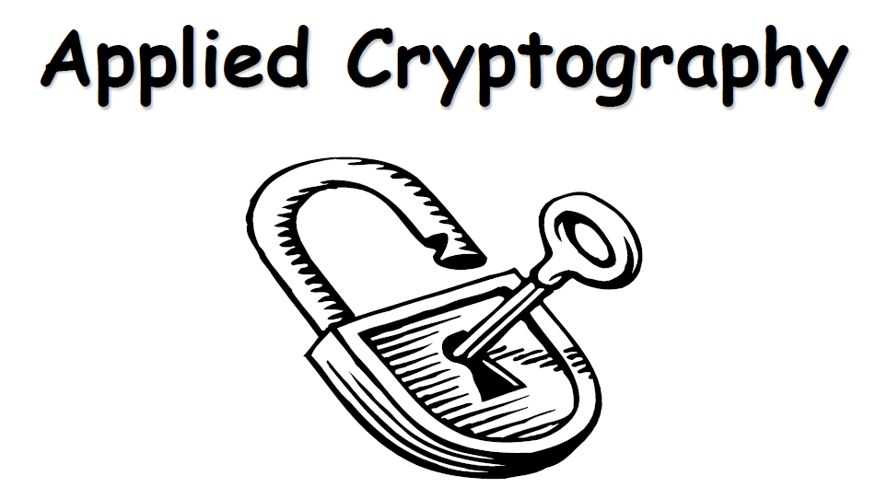

Slide 3
What is this course about?
Objectives
Security needs / threats
Security Goals
Cryptography

Slide 4
What we will cover?
–Vulnerabilities, threats, security Goals, and methods of defense
–Cryptography
–Symmetric
–Asymmetric
–Message authentication and digital signature
–Advances in Cryptography

Slide 5
Vulnerability, Threat and Control
A vulnerability is a weakness in the security system, in procedure, design, or implementation that might be exploited to cause loss or harm
A threat to a computer system is a set of circumstances that has the potential to cause loss or harm
Control is an action, device, procedure, or technique that removes or reduces a vulnerability
A threat is blocked by control of a vulnerability

Slide 6
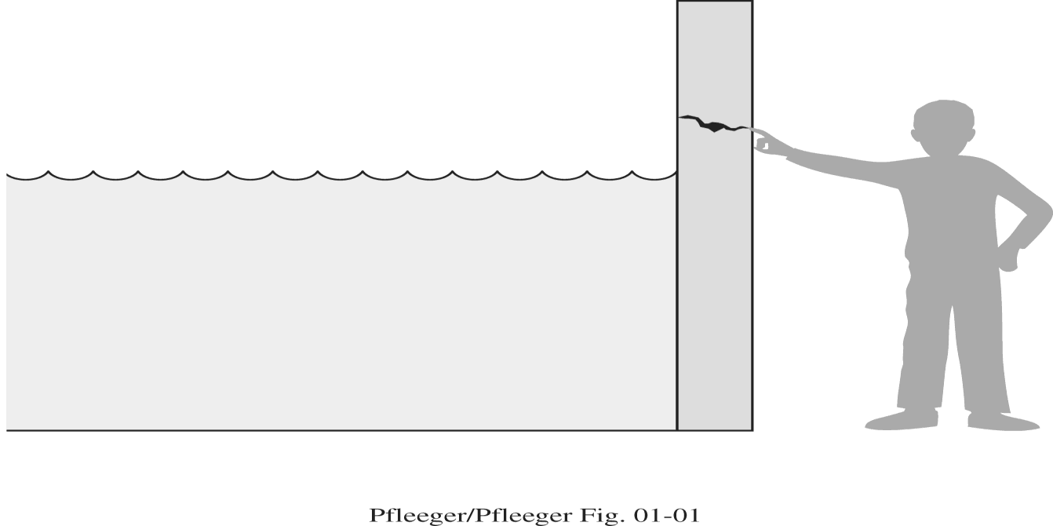
Threats, Controls, and Vulnerabilities

Slide 7
Attacks, Services and Mechanisms
Security Attack: Any action that compromises the security of information.
Security Mechanism: A mechanism that is designed to detect, prevent, or recover from a security attack.
Security Service: A service that enhances the security of data processing systems and information transfers. A security service makes use of one or more security mechanisms.

Slide 8
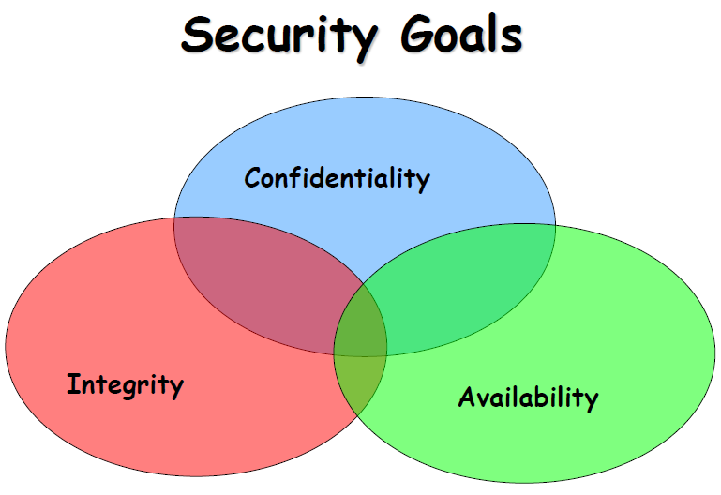
Books

Slide 9
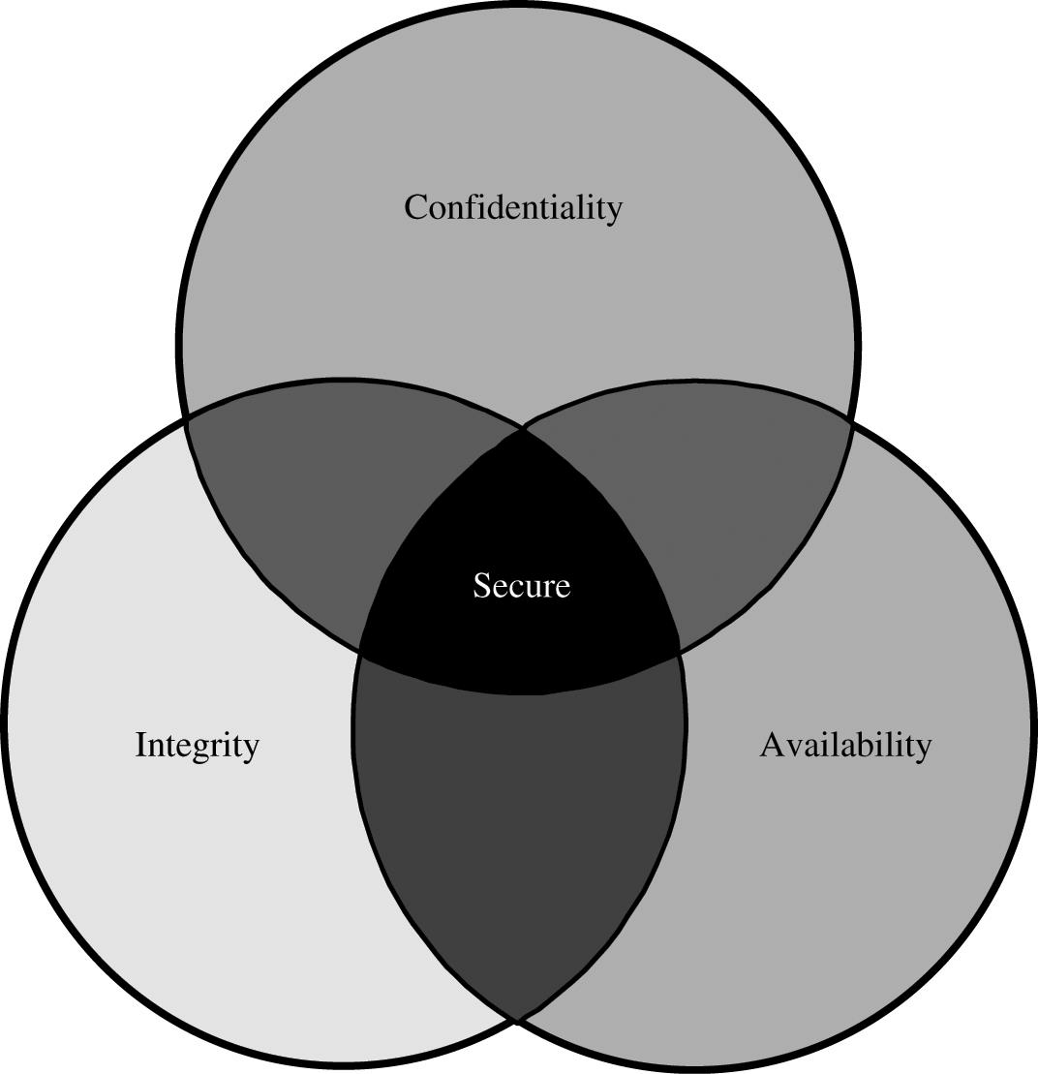
Relationship Between Confidentiality, Integrity, and Availability

Slide 10
Confidentiality
It ensures that computer-related assets are accessed only by authorized parties
Access means reading, viewing, printing, or simply knowing that a particular asset exists
It is sometimes also called secrecy or privacy

Slide 11
Integrity
It means that assets can be modified only by authorized parties only in authorized ways.
The integrity of an item is preserved if it is:
Precise, accurate, unmodified, modified only in acceptable ways, modified by authorized people, modified by authorized processes, consistent, meaningful and usable.

Slide 12
Availability
It applies to both data and data processing
A data item, service or system is available if
There is a timely response to our request
Fair to all i.e. some requesters are not favored over others
Fault tolerant
There is controlled concurrency, deadlock management, and exclusive access as required

Slide 13
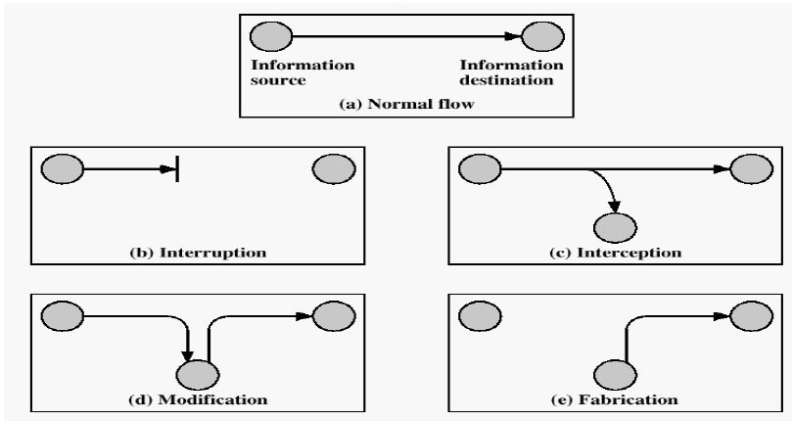
Security Attacks

Slide 15
Security Attacks
Interruption: This is an attack on availability
Interception: This is an attack on confidentiality
Modification: This is an attack on integrity
Fabrication: This is an attack on authenticity

Slide 16
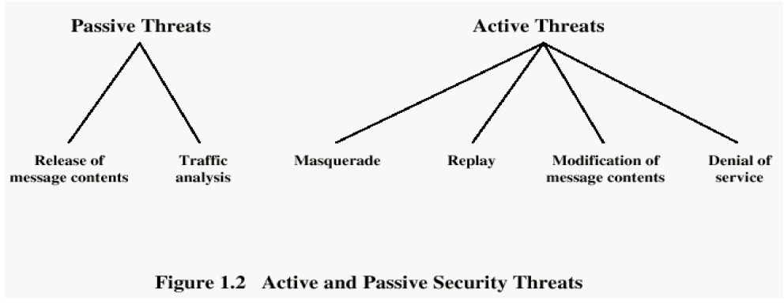

Slide 17
Method, Opportunity and Motive
Method : the skills, knowledge, tools and other things with which to be able to pull off the attack
Opportunity : the time and access to accomplish the attack
Motive : a reason to want to perform this attack against this system
DENY ANY OF THESE THREE THINGS AND
ATTACKS WILL NOT OCCUR

Slide 18
Attacks
Cryptanalytic Attacks
Exploit mathematical weakness of cryptographic algorithm
Non-cryptanalytic Attacks
Threats to goal of security

Slide 19
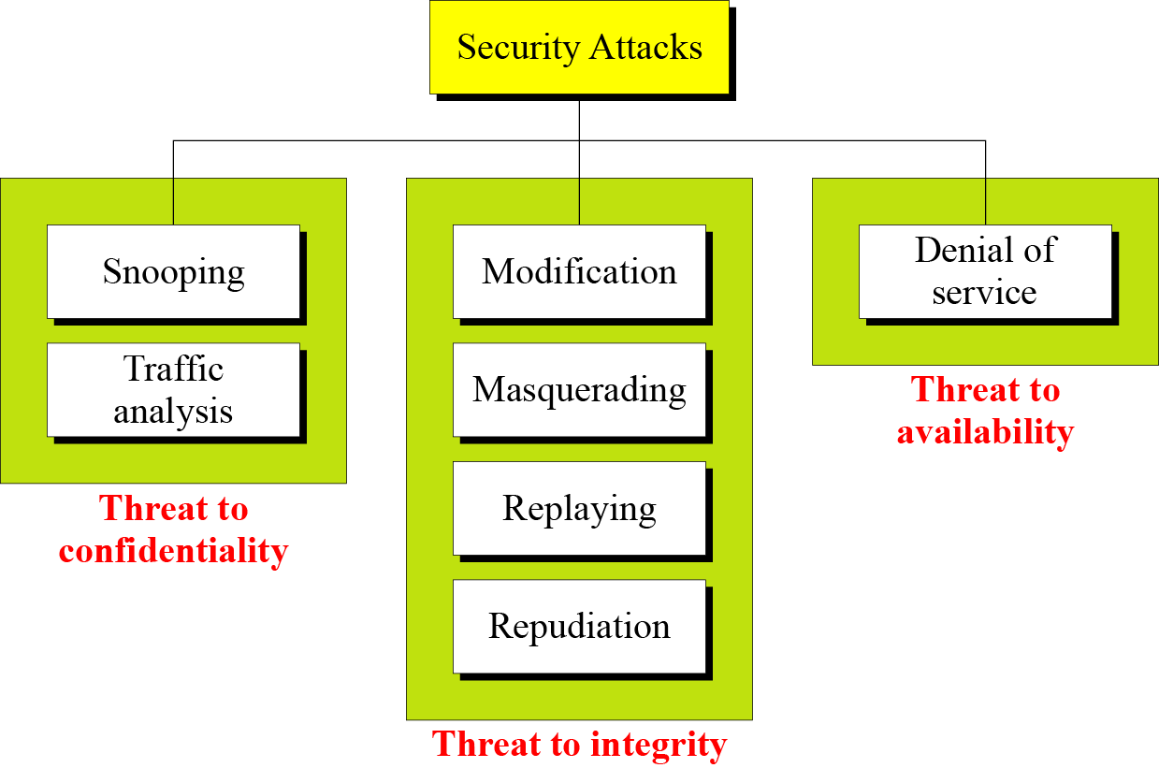

Slide 20
Security Services
Confidentiality (privacy)
Authentication (who created or sent the data)
Integrity (has not been altered)
Non-repudiation (the order is final)
Access control (prevent misuse of resources)
Availability (permanence, non-erasure)
Denial of Service Attacks
Virus that deletes files

Slide 21
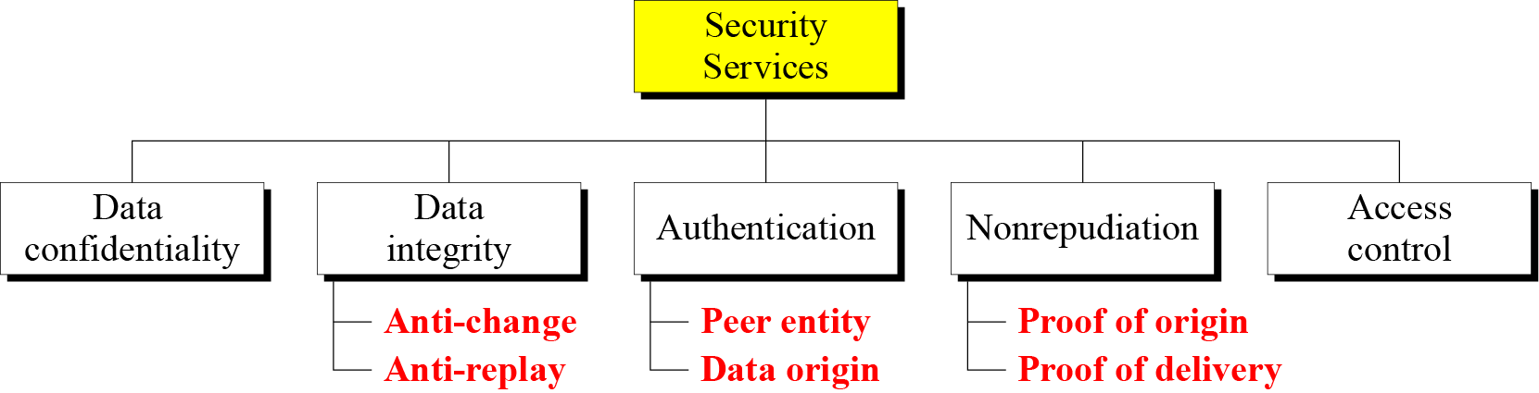

Slide 22
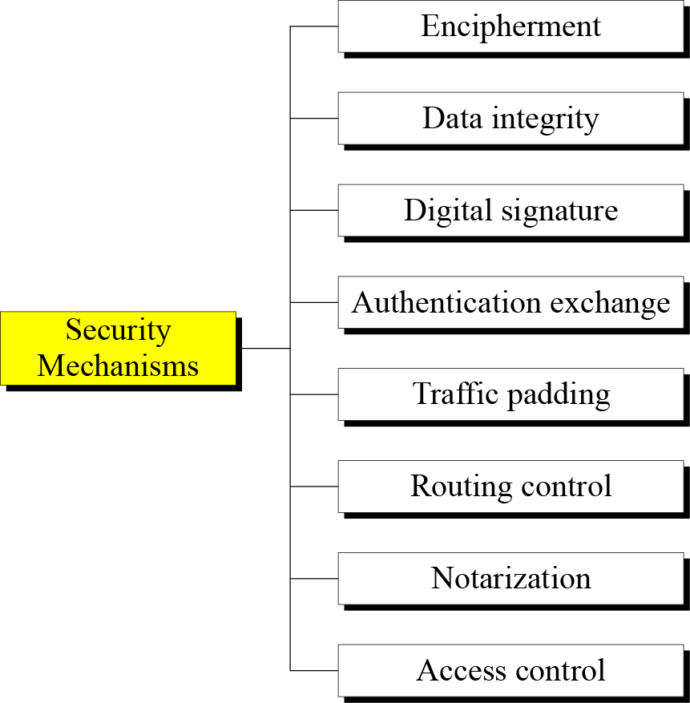

Slide 23
Vulnerabilities
Hardware vulnerabilities
Software vulnerabilities
Software deletion
Software modification
Viruses etc.
Software theft
Unauthorized copying etc.
Data vulnerabilities

Slide 24
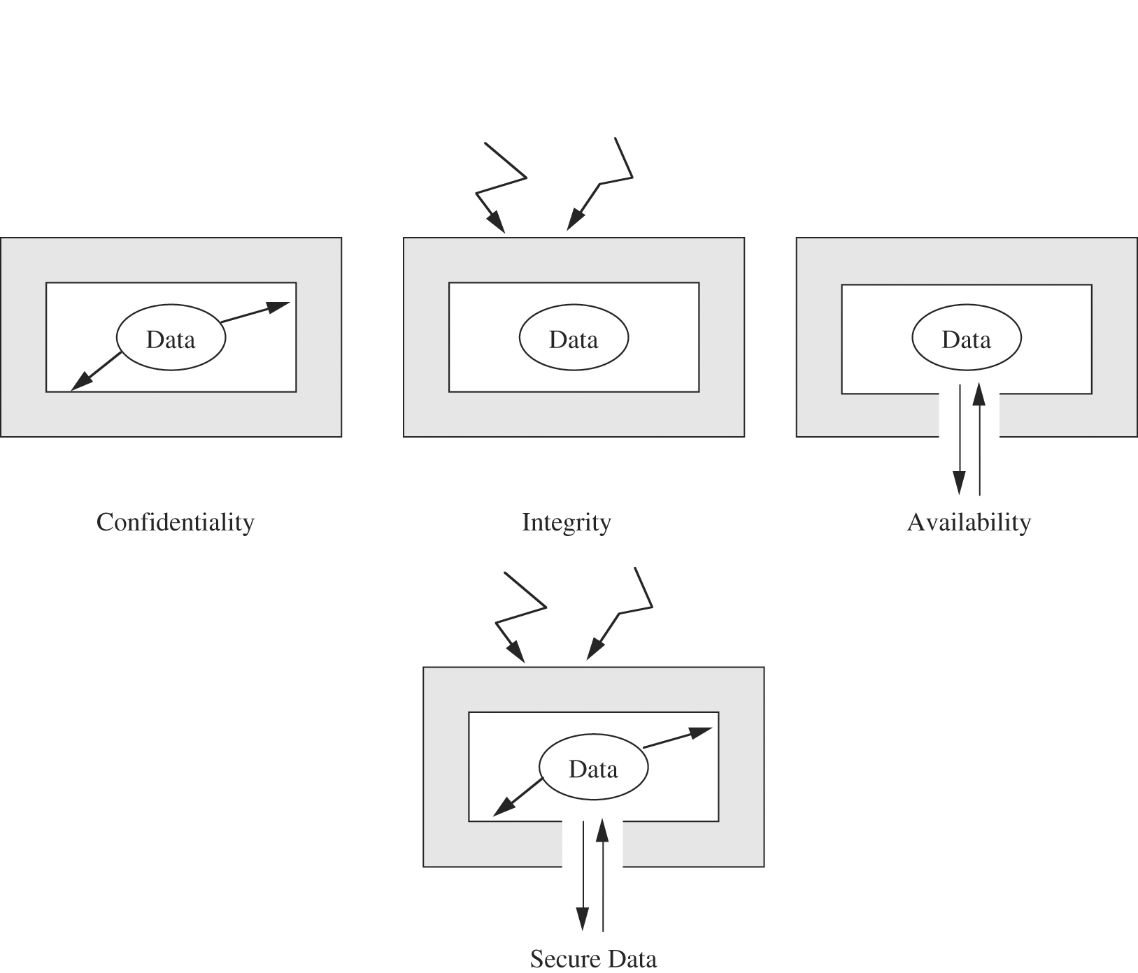
Data Security

Slide 25
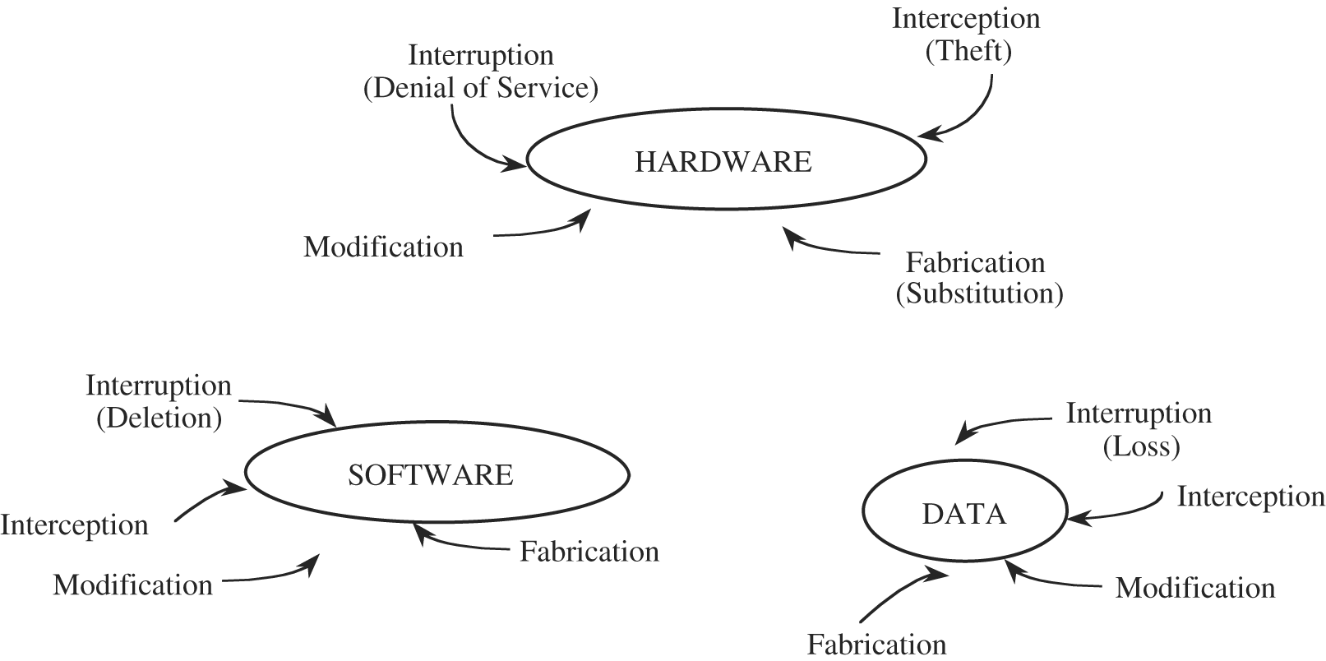
Computing system vulnerabilities

Slide 26
Computer Criminals
Amateurs
Personal works
Crackers
Trying to access computing facilities for which they are not authorized
The perception that nobody is hurt or even endangered by a little stolen machine time
Others attack for curiosity, personal gain, or self-satisfaction
Career Criminals

Slide 27
Methods of Defense
Prevent it, by blocking the attack or closing the vulnerability
Deter it, by making attack harder if not impossible
Deflect it, by making another target more attractive
Mitigate it, by making its impact less severe
Detect it, either as it happens or some time after the fact
Recover from its effects

Slide 28
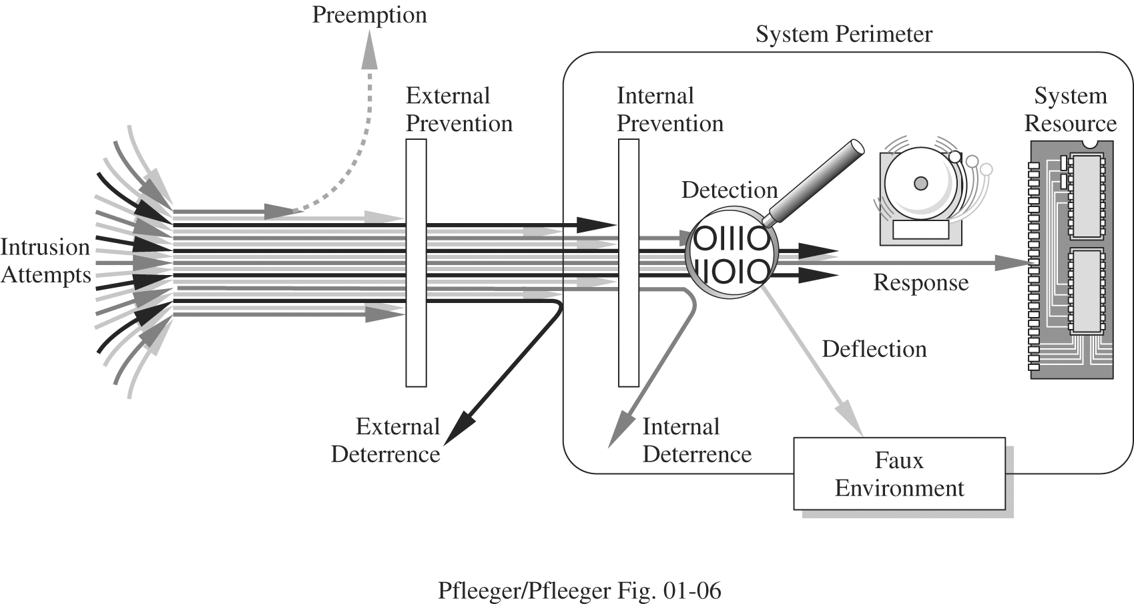

Slide 29
Methods of Defense
Controls
Encryption
Hardware Controls
Hardware/smart card implementations of encryption
Locks or cables limiting access
Devices to verify users’ identity
Firewalls
Intrusion detection systems
Software Controls
Internal program controls,
OS and Network system controls
Independent control program (anti virus, passwords etc.)
Development control
Policies and Procedures
Physical Controls

Slide 30
Effectiveness of Controls
Awareness of Problem
Highlighting Need of security
Likelihood of Use
They must be efficient, easy to use, and appropriate
Overlapping Controls
Use several different controls, layered defense
Periodic reviews
Judging the effectiveness of control is an ongoing task

Slide 31
Others Exposed Assets
Networks
Network’s lack of physical proximity
Use of insecure, shared media
Inability to identify remote users positively
Access
Computer time
Malicious access
Denial of service to legitimate user
Key People

Slide 32
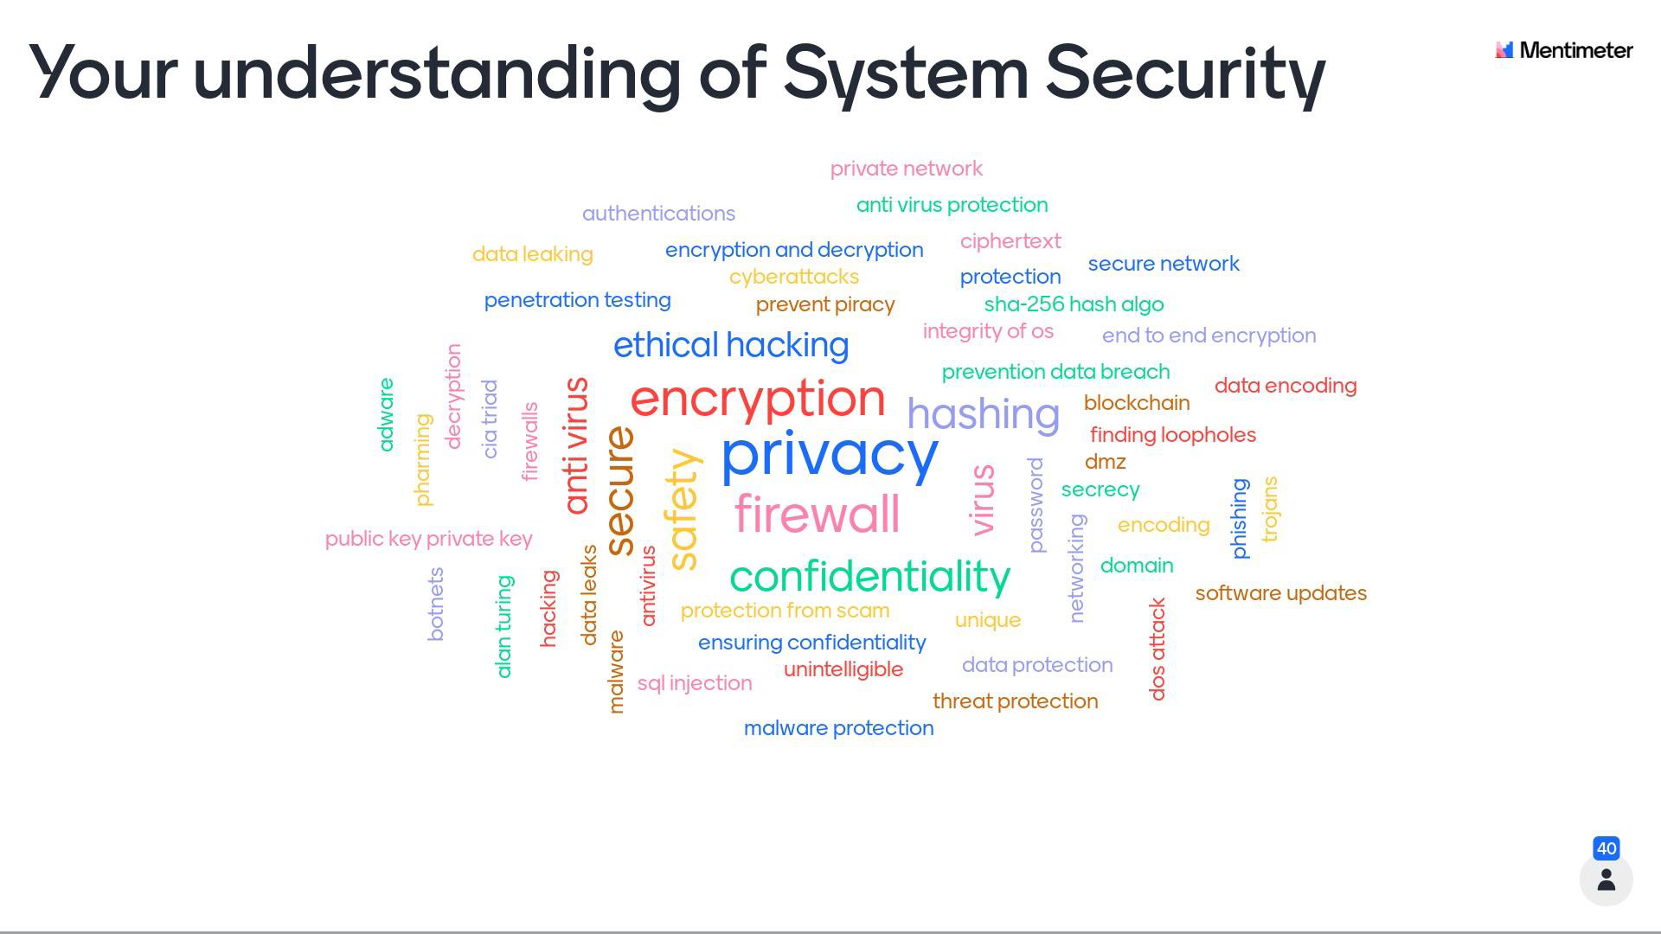

Slide 33
What’s Next?
Encryption overview
Cryptography in detail

Slide 34
Questions?

